Slide 1
Open House Public Meeting for BNSF RR Crossings in Baldwin St. Mary Parish
State Project No. H.011706
Federal Aid Project No. H011706
Baldwin Community Center
305 LA Highway 83
Baldwin, LA
July 24, 2019
5:00 - 7:00 p.m.
Notes:
Welcome to the Open House Public Meeting for the BNSF Railroad Crossings project located in the Town of Baldwin, St. Mary Parish. The meeting is being held by the Louisiana Department of Transportation and Development, in conjunction with the Federal Highway Administration.

Slide 2
Objective of Public Meeting
Provide information about the proposed project
Solicit comments about the project from the public and other interested parties
Notes:
The purpose of tonight’s meeting is to provide information about the proposed project and to solicit comments about the project from the public and other interested parties.

Slide 3
Preliminary Project Description
Permanently close three (3) railroad crossings along the BNSF/LDRR railroad.
Lockley Street, Orphan’s Home Road, and Havens Street
Construction of connector roads.
Connect Rosebud St. with Lockley St.
Connect Havens St. with Newman St.
Additional right of way may be required; however, relocations are not anticipated. Slides outlining DOTD’s Acquisition of Right of Way process are included later in this power point presentation.
Notes:
The proposed project will extend or construct connecting roads between Rosebud and Lockley Street and between Havens and Newman Street in order to allow for the closure of the railroad crossings over Lockley Street, Orphan’s Home Street, and Havens Street. This will allow drivers to use the Rosebud and Newman crossings which have active warning devices, fewer railroad tracks in the crossings, and are not as steep.
The crossings that are proposed to be closed will be complete closures.

Slide 4
Project Purpose and Need
The purpose of this project is to improve safety of the BNSF railroad corridor by eliminating three (3) crossings and directing drivers to crossings that have active warning devices and fewer tracks.
Notes:
The purpose of this project is to improve safety of the BNSF railroad corridor by eliminating three (3) crossings and directing drivers to crossings that have active warning devices, fewer tracks, and better geometry by constructing connecting roads.

Slide 5
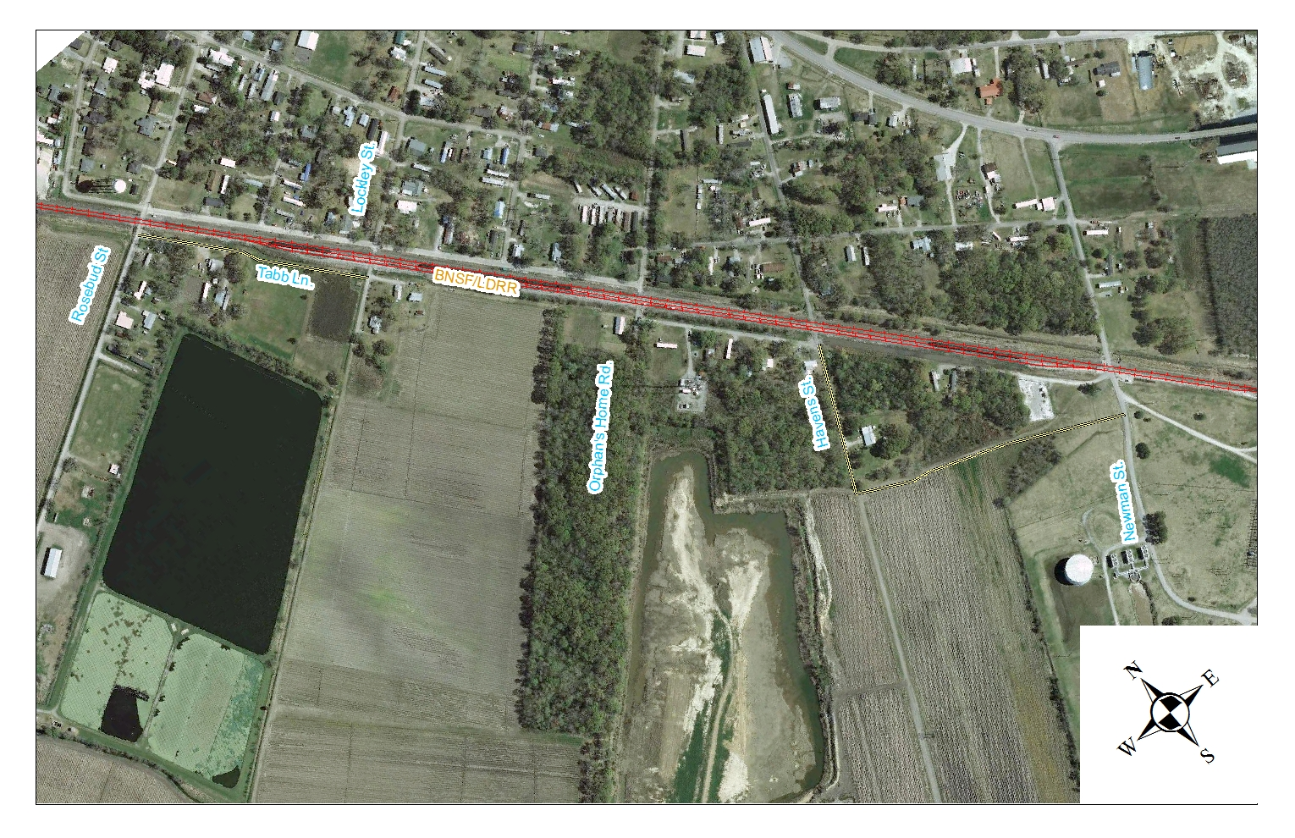
Proposed Project Location
Begin Project
End Project
Notes:
The proposed project is located along the BNSF Railroad between Rosebud Street and Newman Street, in the Town of Baldwin, St. Mary Parish.

Slide 6
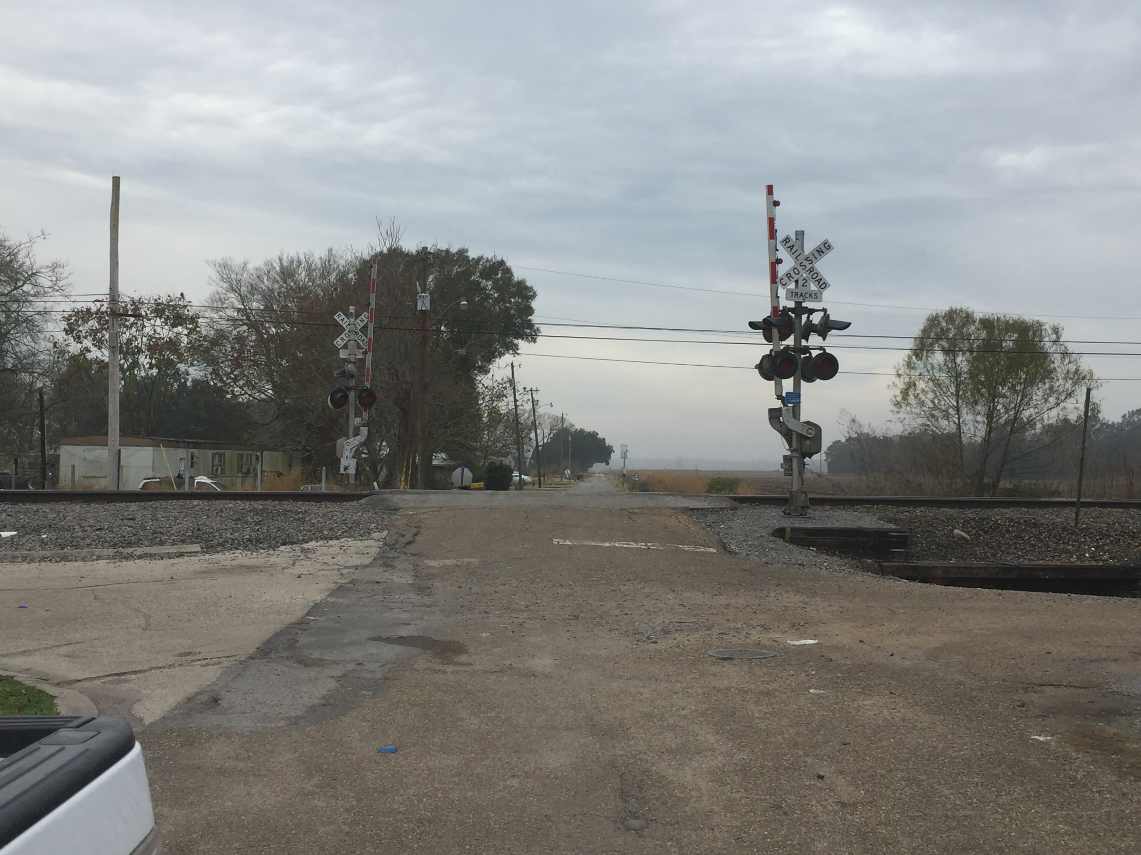
Rosebud Street
Roadway crosses 2 tracks.
Crossing will remain open
Notes:
The Rosebud Street crossing contains 2 active tracks with active warning devices. At the Rosebud Street crossing, proposed work includes creating a connection with Lockley Street, possibly by extending Tabb Lane.

Slide 7
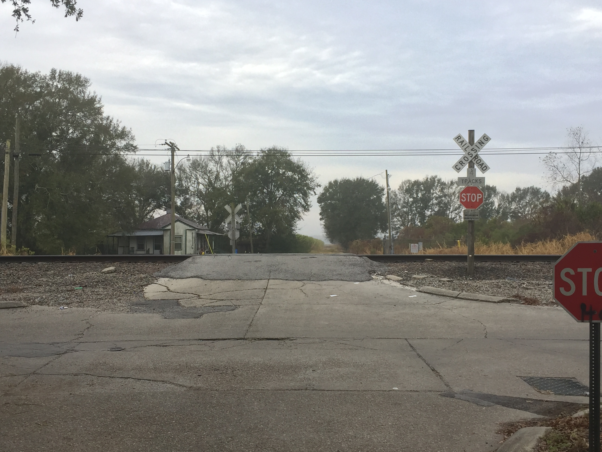
Lockley Street
Roadway crosses 3 active tracks (1 track ends just outside the roadway).
Crossing will be closed
Access maintained with proposed extension of Tabb Lane from Rosebud Street.
Notes:
The Lockley Street crossing contains 3 active tracks, 1 abandoned track, and passive warning devices. At the Lockley Street crossing, proposed work includes connecting Lockley Street with Rosebud Street, possibly through Tabb Lane, the closure of the roadway crossing the railroad (removal of the crossing surface, removal of the road approaches, re-sloping the ditch line to facilitate drainage, and the installation of an end of roadway barricade).

Slide 8
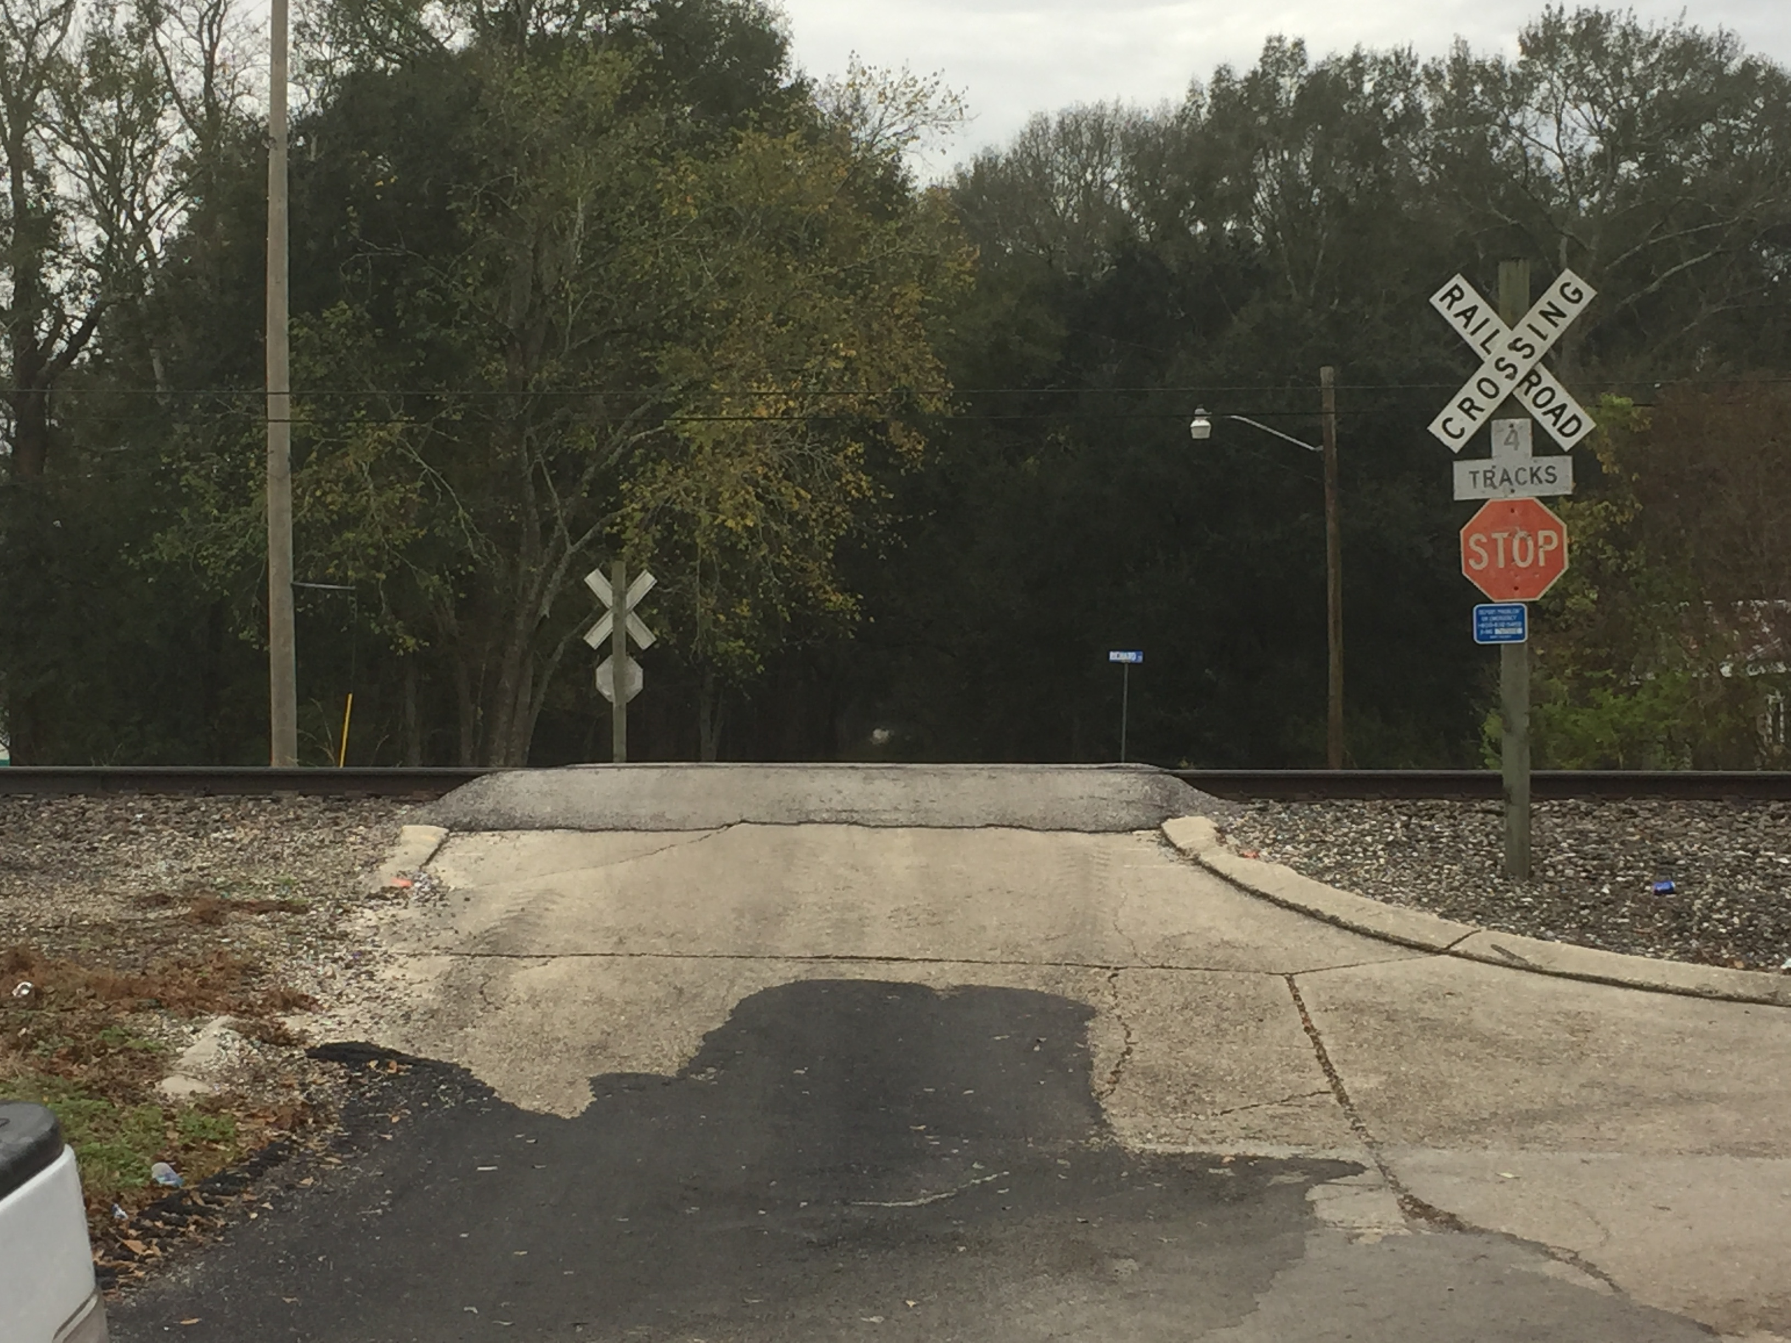
Orphan’s Home Rd.
Roadway crosses 3 active tracks (1 inactive track ends just outside the roadway).
Crossing will be closed
Existing roadway connection with Havens St.
Notes:
The Orphan’s Home Road crossing contains 3 active tracks, 1 abandoned track, and passive warning devices. At the Orphan’s Home Road crossing, proposed work includes connecting Orphan’s Home Road with Havens Street and Newman Street, the closure of the roadway crossing the railroad (removal of the crossing surface, removal of the road approaches, re-sloping the ditch line to facilitate drainage, and the installation of an end of roadway barricade). There is an existing roadway connecting Orphan’s Home Road with Havens Street which would be upgraded to handle increased traffic, if needed.

Slide 9
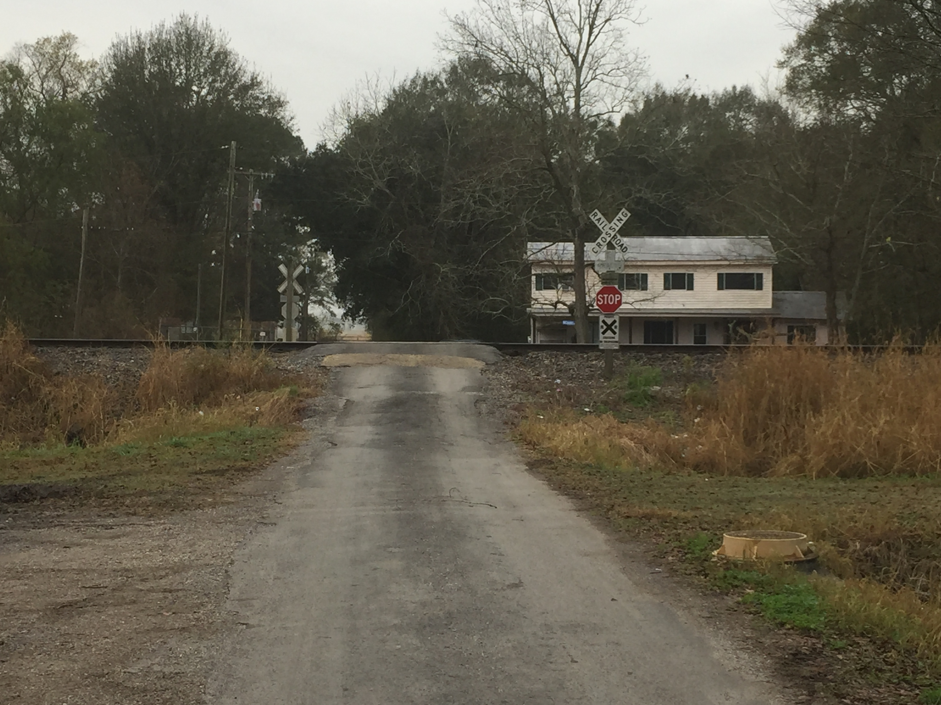
Havens Street
Roadway crosses 3 active tracks.
Crossing will be closed.
Access maintained with proposed new road connecting to Newman Street
Notes:
The Havens Street crossing contains 3 active tracks and passive warning devices. At the Havens Street crossing, proposed work includes connecting Havens Street with Orphan’s Home Road and Newman Street, the closure of the roadway crossing the railroad (removal of the crossing surface, removal of the road approaches, re-sloping the ditch line to facilitate drainage, and the installation of an end of roadway barricade). There is an existing roadway connecting Orphan’s Home Road with Havens Street which would be upgraded to handle increased traffic, if needed.

Slide 10
Newman St.
Roadway crosses 2 tracks.
Crossing will remain open
Notes:
The Newman Street crossing contains 2 active tracks with Active Warning Devices. At the Newman Street crossing, proposed work includes constructing a road to connect with Havens Street and Orphan’s Home Road.

Slide 11
Conceptual Alignments
The following are conceptual alignments for the connector roads developed in cooperation with the Town. They attempt to minimize impact to adjacent property owners and the natural environment. These alignments may be changed based on feedback from this meeting as well as information obtained during the plan development process.
Notes:
Conceptual Alignments have been developed in cooperation with the Town. The alignments attempt to minimize impact to the adjacent property owners and the natural environment. They may be changed based on feedback from this meeting or new information obtained during the plan development process.

Slide 12
Connecting roads proposed for construction
Proposed Connecting Roads
Connector roads proposed between Rosebud St. and Lockley St. and between Havens St. and Newman St. Some right of way will be required. Preliminary alignments of proposed connector roads developed based on discussion with Town.
Notes:
A connecting road is proposed from the Rosebud Street to Lockley Street (possibly by extending Tabb Lane) to maintain Lockley Street’s connectivity. Another connecting road is proposed between Havens Street and Newman Street to maintain the connectivity of Orphan’s Home Road and Havens Street. The existing roadway between Orphan’s Home Road and Havens Street will be evaluated to make sure it can accommodate the additional traffic. Right of way will be required for the new connector roads.

Slide 13
STEPS IN THE ACQUISITION PROCESS
STEPS IN THE ACQUISITION PROCESS
DOTD’s objective is to pay Just Compensation for all properties required for the project.
Owners may be contacted by an appraiser(s) to evaluate their property.
All evaluations will be approved by DOTD.
After approval a Real Estate agent will contact each property owner with a letter detailing DOTD’s offer for the purchase of the property.
Owners will be given a set timeframe to accept or counter DOTD’s offer
Notes:
DOTD’s objective is to pay Just Compensation for all properties required for the project.
Owners may be contacted by an appraiser(s) to evaluate their property.
All evaluations will be approved by DOTD.
After approval a Real Estate agent will contact each property owner with a letter detailing DOTD’s offer for the purchase of the property.
Owners will be given a set timeframe to accept or counter DOTD’s offer.

Slide 14
RIGHT OF WAY ACQUISITION INFORMATION
A Real Estate representative is here at the meeting to explain DOTD’s right of way acquisition and relocation procedures.
The DOTD Brochure explaining the Acquisition of Right of Way is available at Station 4.
If you have property affected by this project, we suggest you read the brochure carefully. If you have any questions regarding your individual situation, consult with the agent when he or she meets with you or contact the Region Real Estate Office.
Notes:
A real estate representative is here at the meeting to explain LADOTD’s right of way acquisition procedures.
The DOTD Brochure explaining Acquisition of Right-of-Way is available tonight at Station 4 or can be obtained later by contacting the DOTD Real Estate Section at the address and telephone number listed in your handout.
If you have property affected by this project, we suggest you read the brochure carefully. If you have any questions regarding your individual situation, consult with the agent when she or he meets with you, or contact the Region Real Estate Office.

Slide 15
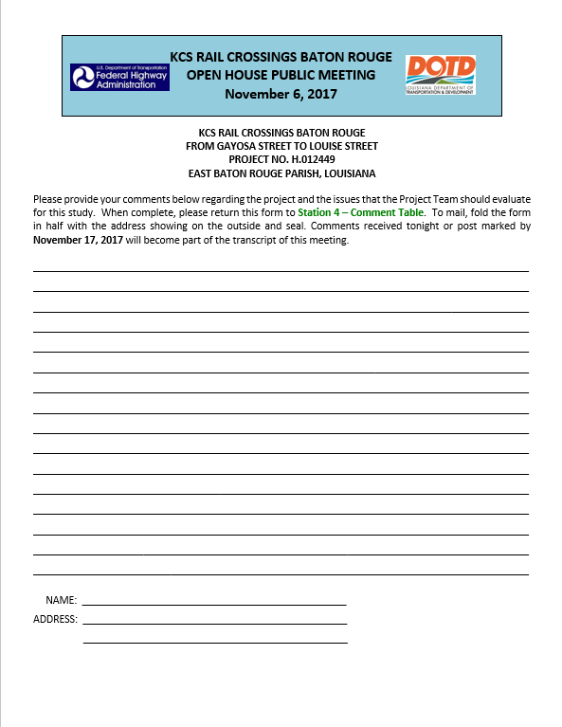
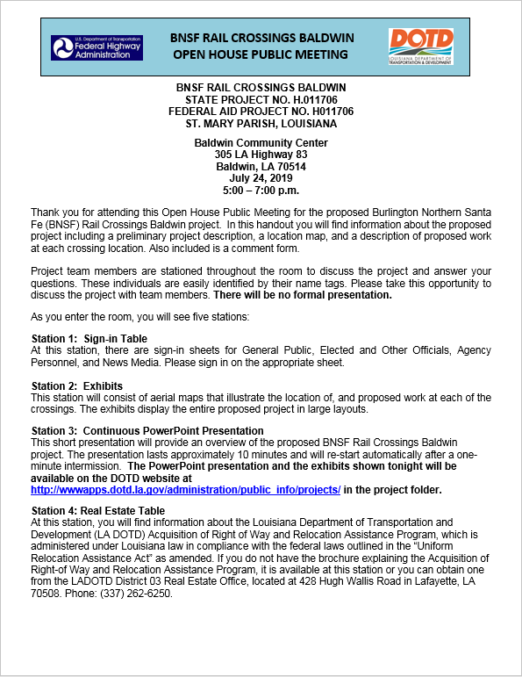
Why Comment?
Community concerns and preferences are factors that are considered
All comments must be considered in this environmental process
We need to know if there are any resolvable issues or opportunities with the project.
Notes:
Thank you for your interest in tonight’s meeting. If you wish to make a comment, verbal or written, please see a staff member at the Comment Table. Comment forms are provided as the last page of your meeting handout. Additional forms are locate at the comment table as well.
Your comments are important because community concerns and preferences are factors that are considered in this project. We need to know if there are any issues or opportunities with the project as proposed.
Comments received tonight or post-marked by November 17 will be part of the transcript of this public meeting.

Slide 16
This is the end of the presentation. Thank you for your time. Please visit the remaining stations to view the exhibits and provide comments.
Notes:
Again, thank you for your participation in this Public Meeting. Please visit the remaining stations to view the exhibits and provide your comments.

Slide 17
Welcome The presentation will be repeated throughout tonight’s meeting and will begin shortly.
Notes:
Welcome The presentation will be repeated throughout tonight’s meeting and will begin shortly.

